Slide 1
PYTHON PRESENTATION Does tobacco have anything to do with GDP per capita, alcohol, or gender?
Group 2
Nguyen Mai Linh (Sandy) - 20229031
Farhan Toshi Hermawan - 20229531
Fariha Qorinatuz Zahra - 21229529

Slide 2
AGENDA
Research questions and hypotheses
Understand the Data
General graphs
Analysis
​Conclusion
References

Slide 3
BACKGROUND
Tobacco use is a much discussed topic in daily lives and in the world.
Some countries have a lot of smokers, some do not, despite the similarity in the message in the packaging of tobacco, for example, “Smoking causes lung cancer.”
Understanding the trend of the prevalence of tobacco use with consideration of other factors can be insightful to tobacco policies.

Slide 4
RESEARCH QUESTIONS
What is the relationship between a country's GDP per capita and its tobacco use prevalence, and how has this relationship evolved over time?
What is the relationship between a country’s alcohol use and tobacco use prevalence, and how has this relationship evolved over time?
Are there gender-based differences in tobacco use, and if so, how have these differences evolved in over time?

Slide 5
HYPOTHESES
Economically advantaged countries have higher prevalence of tobacco use, while economically disadvantaged countries have lower prevalence.
Countries with higher prevalence of alcohol use also have higher prevalence of tobacco use.
Economically advantaged countries has more equal consumption between male and female tobacco use, and the opposite goes for economically disadvantaged countries.

Slide 6
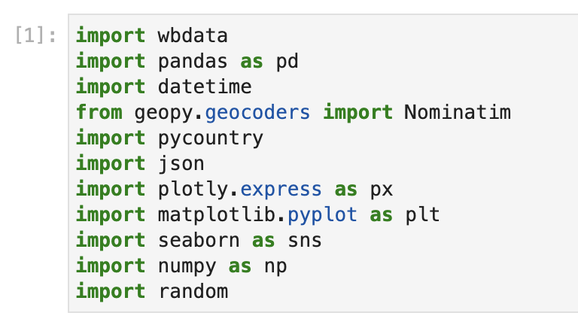
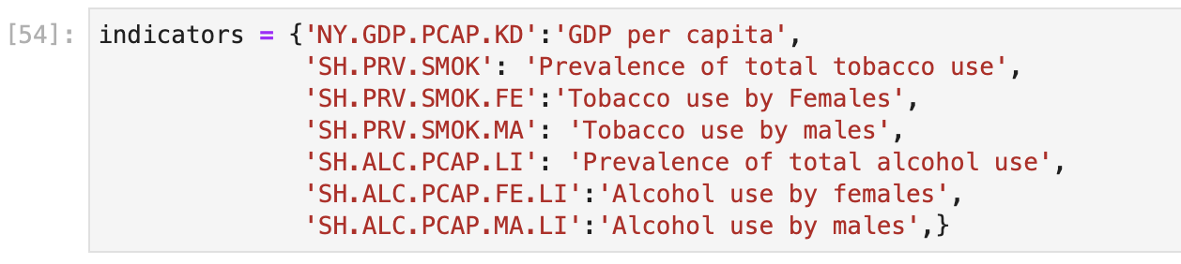
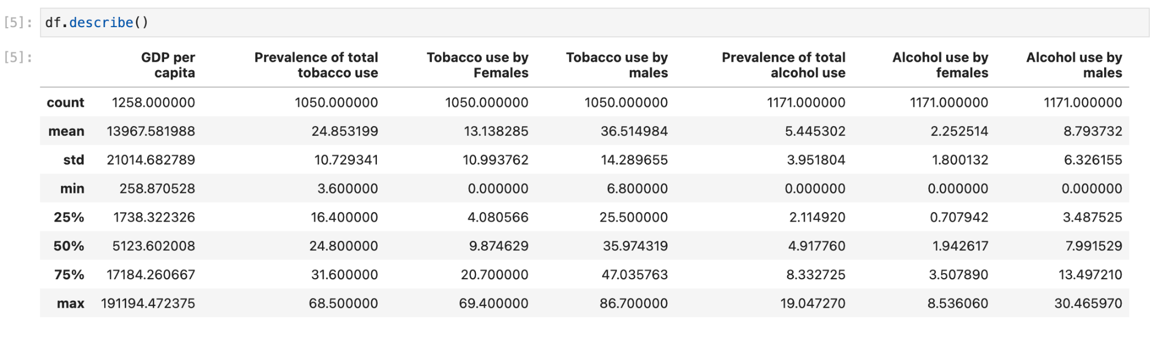
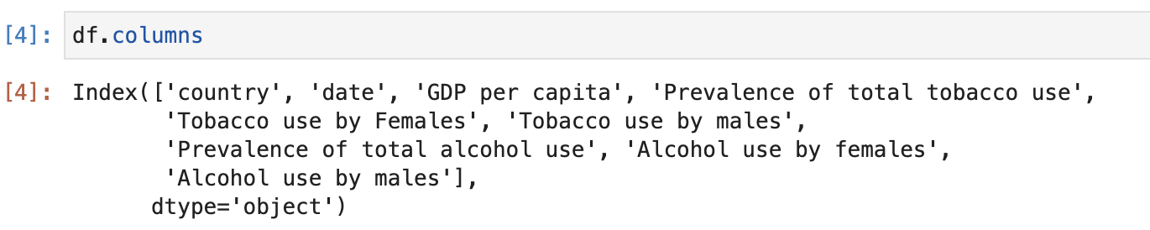
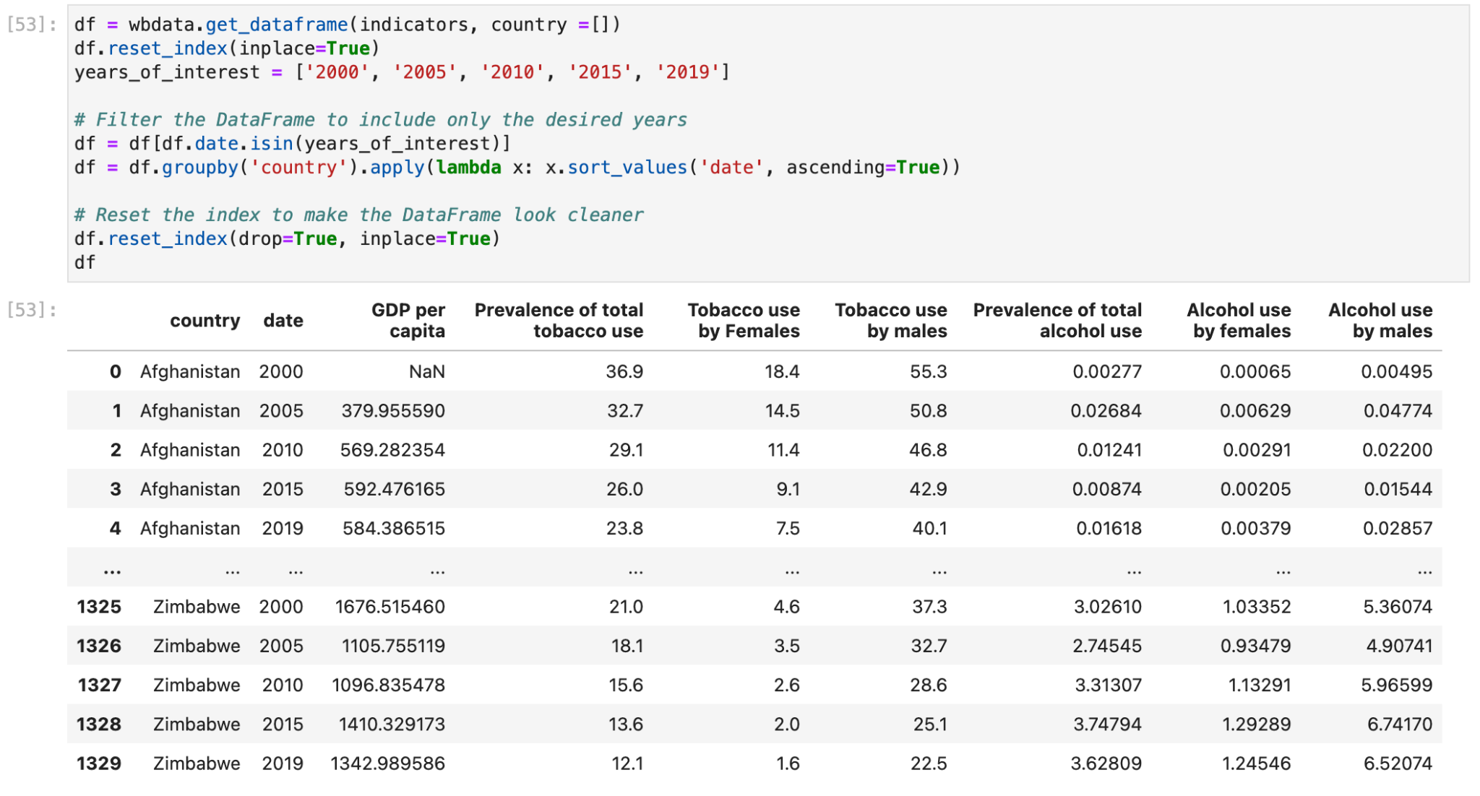
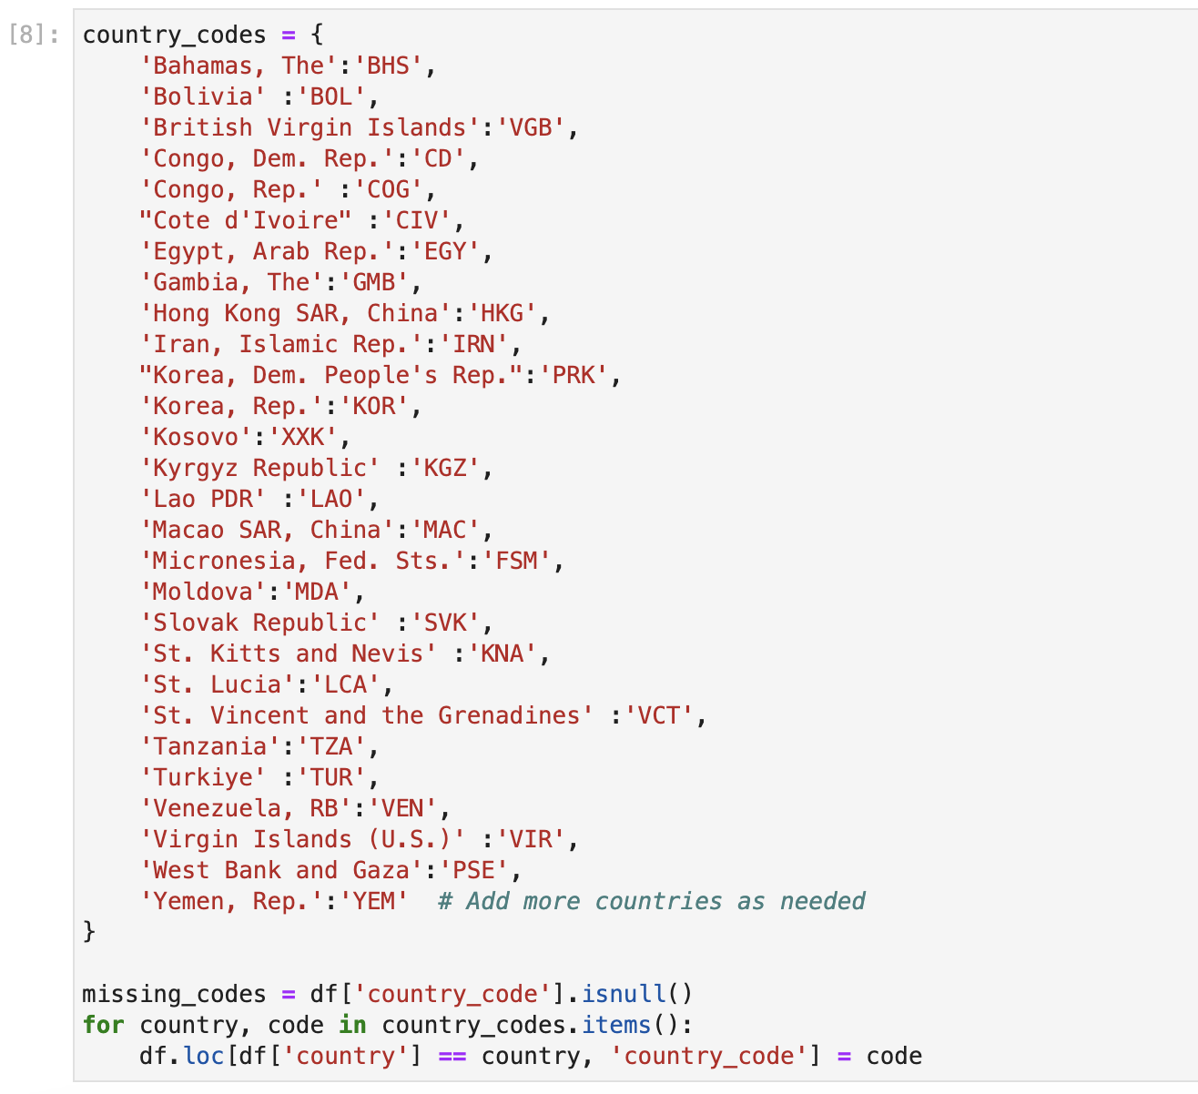
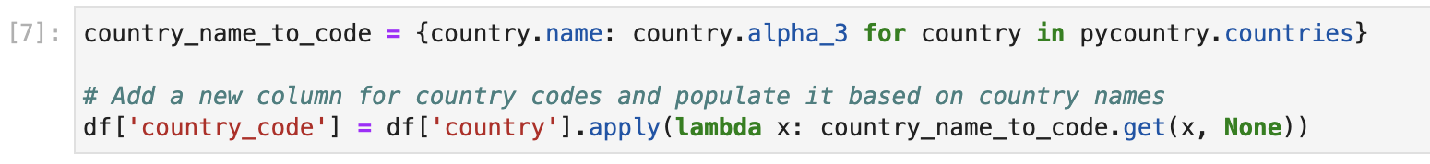
UNDERSTANDING DATA
Import libraries
State necessary data indicators
Filter years of interest
Assigning countries to their codes
Change country code format to ISO 3 - Alpha 3

Slide 7
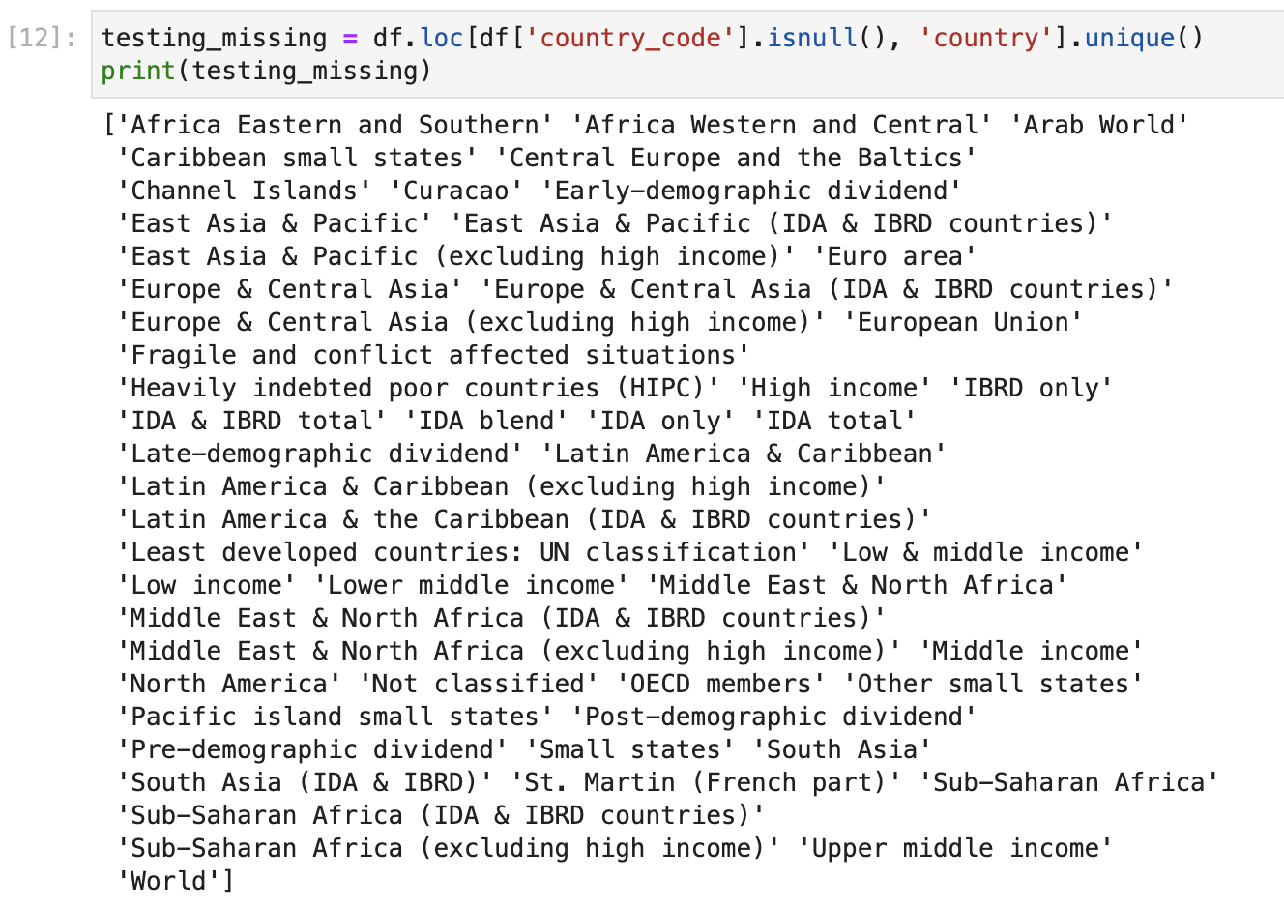
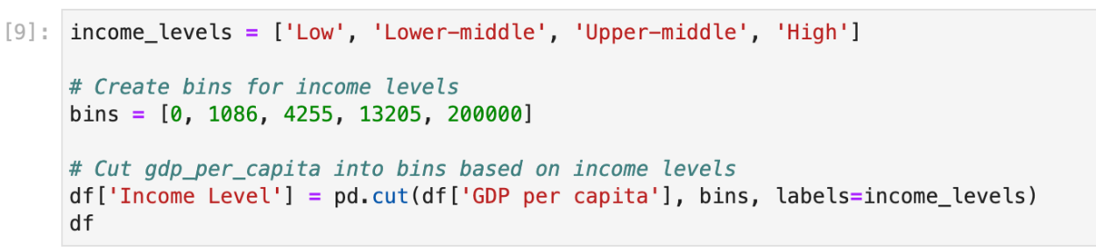
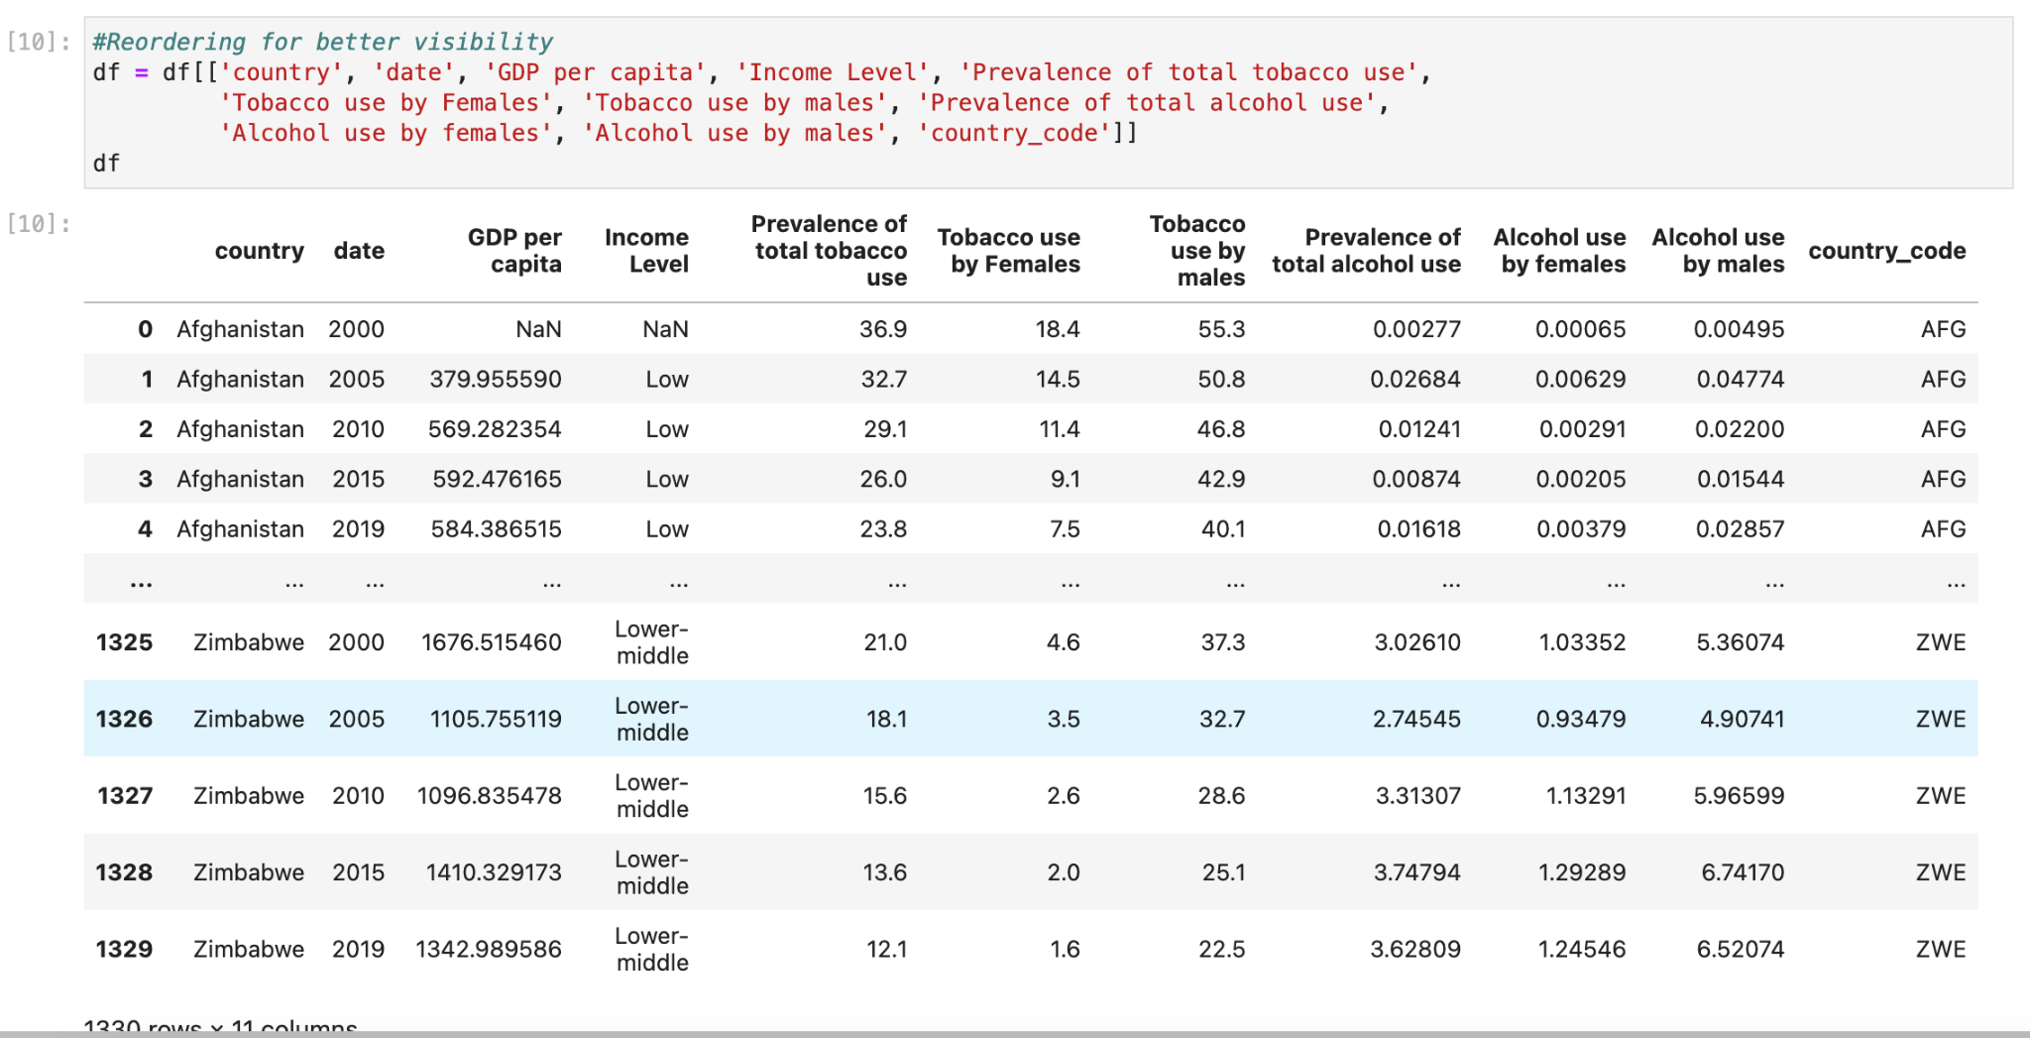
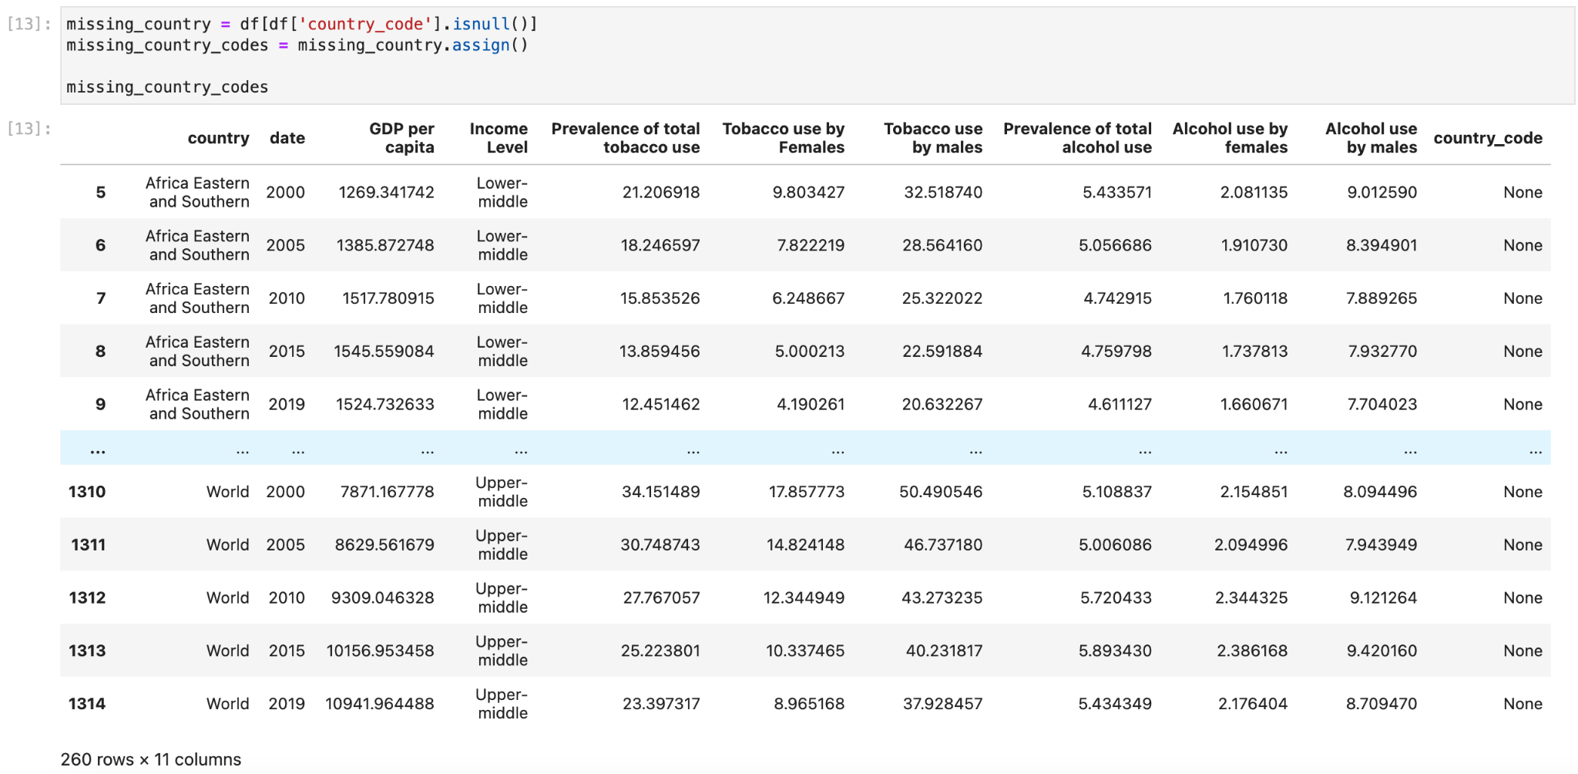
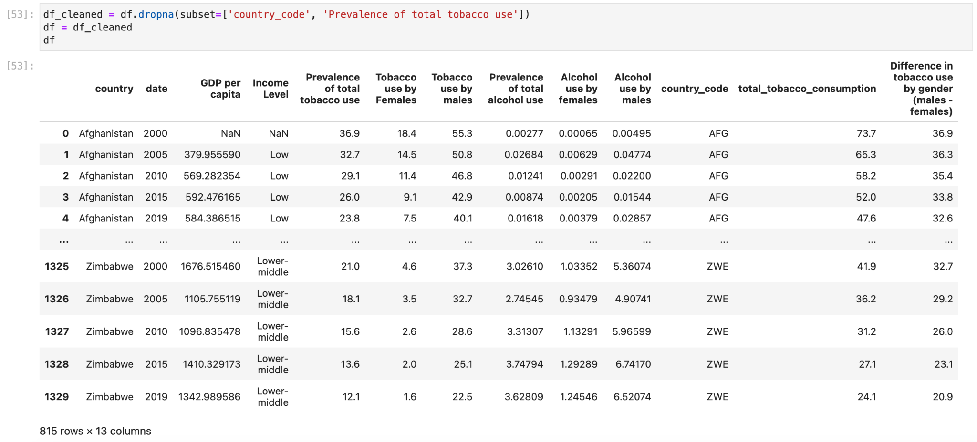
UNDERSTANDING DATA
Show non-country values
Create a new column for income levels based on GDP per capita
Reorder the whole dataframe columns
Put non-country values into a different dataframe
Drop them from the original dataframe

Slide 8
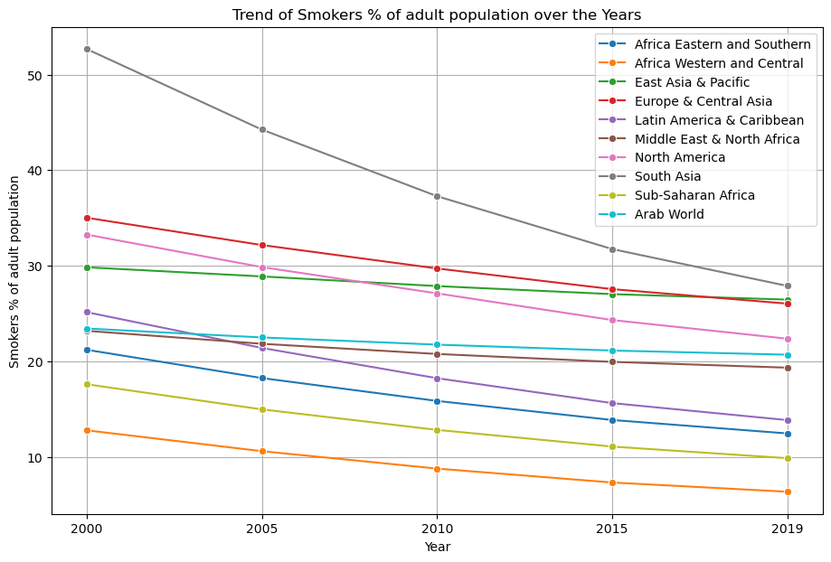
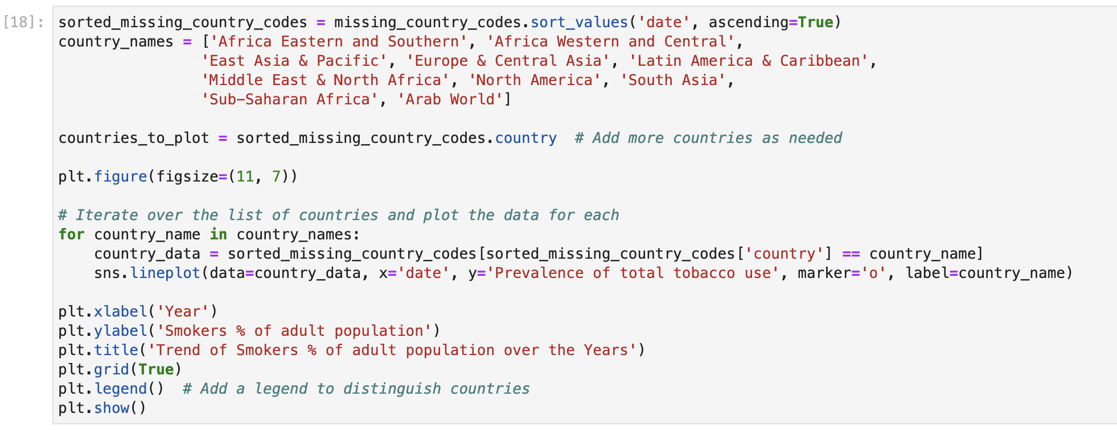
GENERAL VISUALIZATIONS
Interpretation:
It’s notable that the trend is decreasing over the years.
Africa has the lowest trend of smokers over the years while South Asia has the highest one yet.
South Asia experienced the biggest decline over the range of 2000 - 2019.

Slide 9
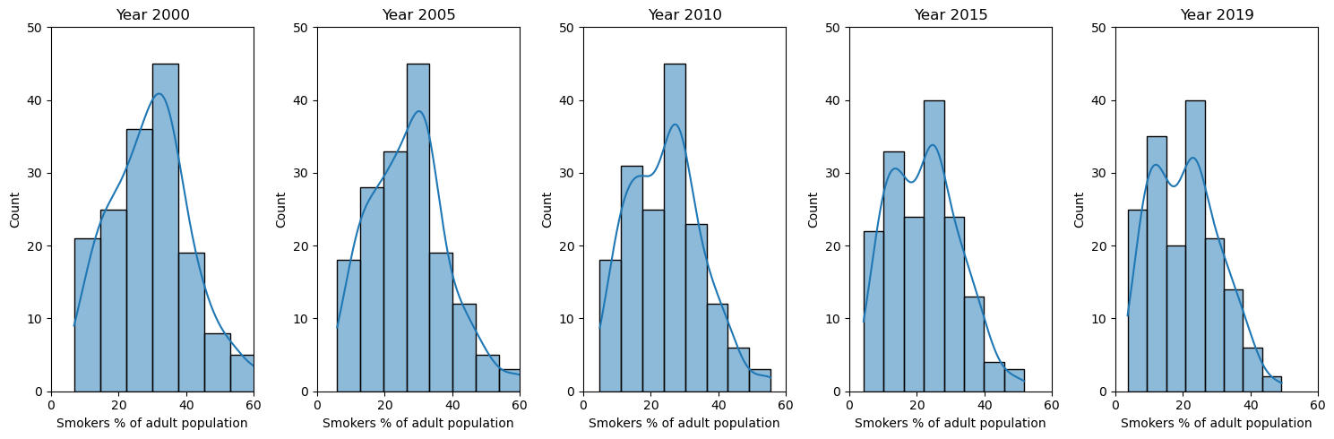
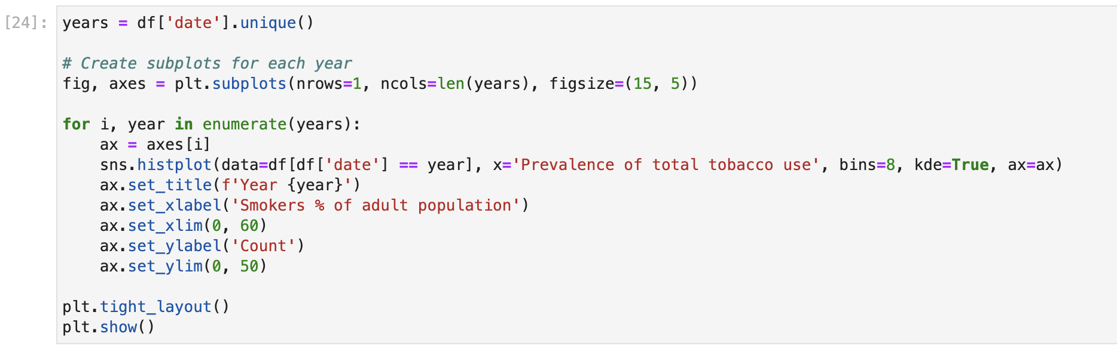
GENERAL VISUALIZATIONS
Interpretation:
The range of prevalence in most countries is mainly focused on 20 to 40% of smokers earlier in the period.
Later, the range decreases into mostly 15 to 25% of smokers in most of the countries.

Slide 10
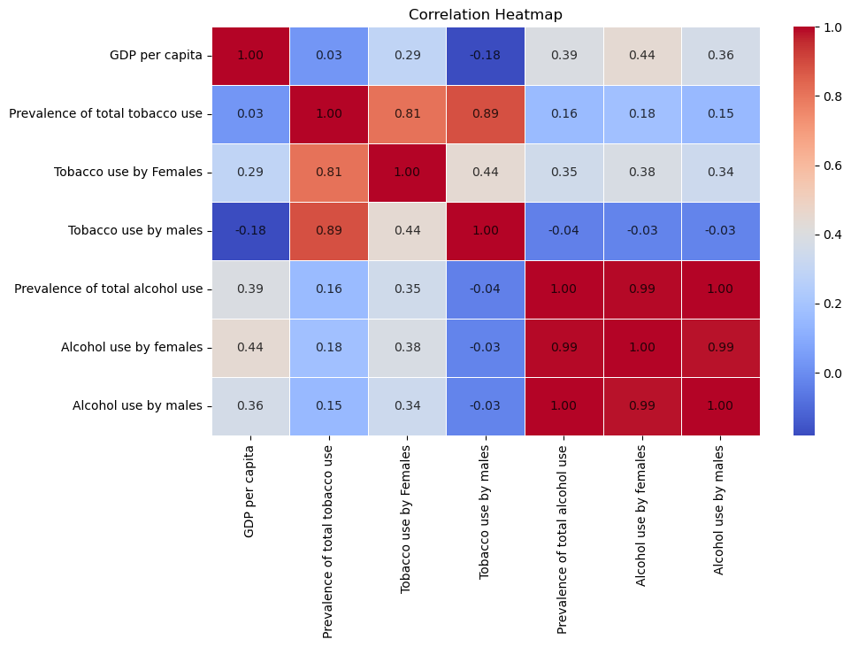
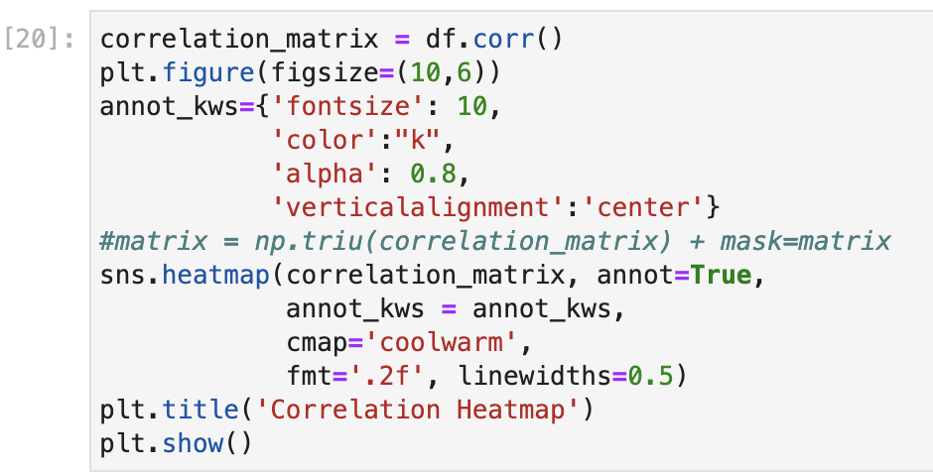
GENERAL VISUALIZATIONS

Slide 11
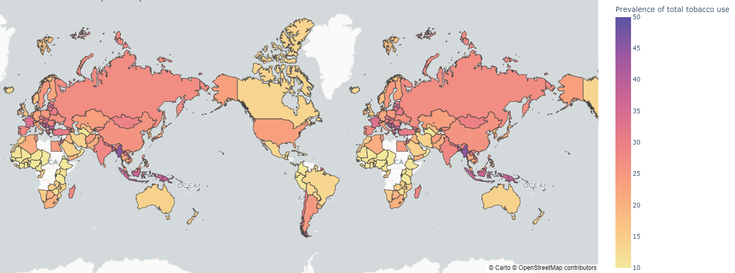
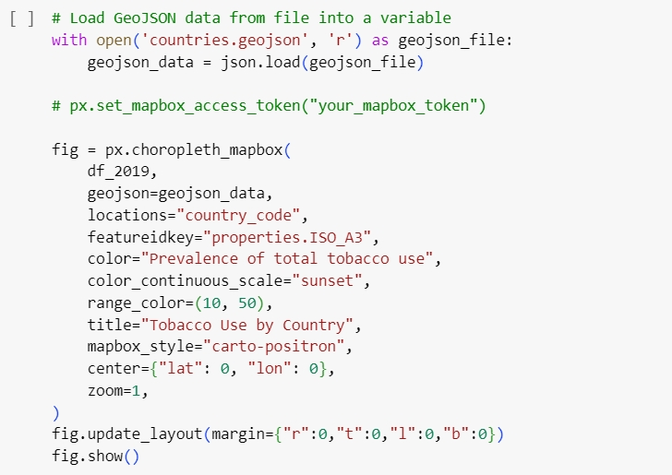
GENERAL VISUALIZATIONS

Slide 12
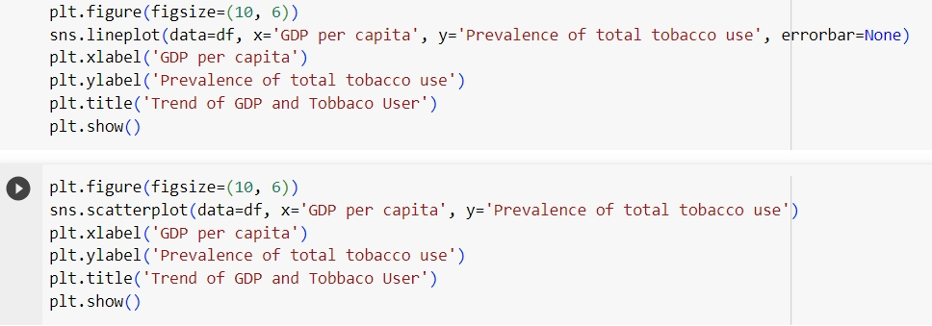
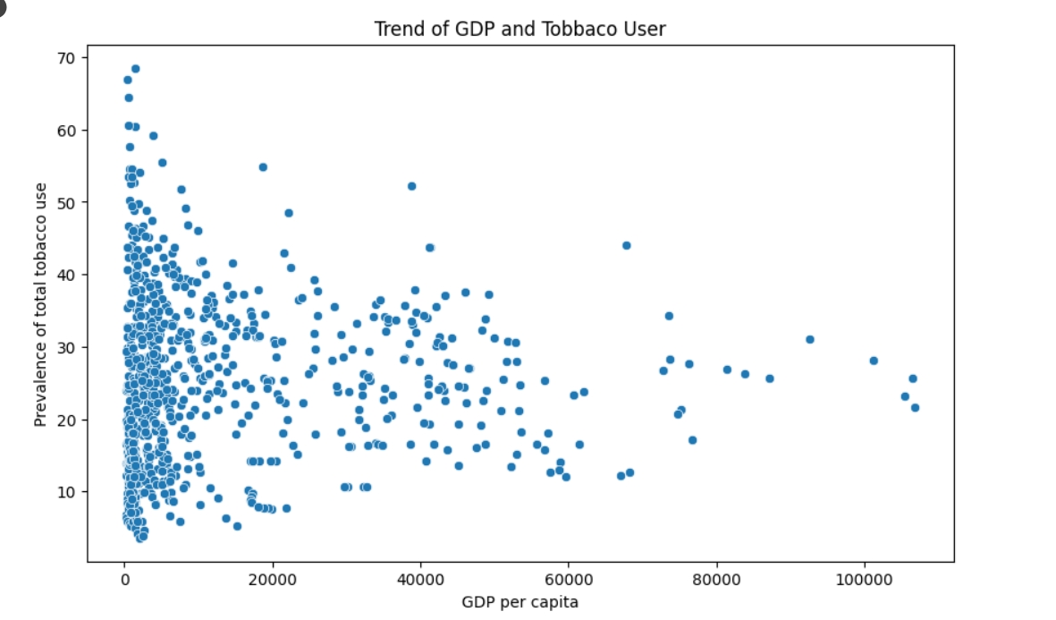
Hypothesis #1: The more economically advantaged a country is, the higher the prevalence of tobacco use.

Slide 13
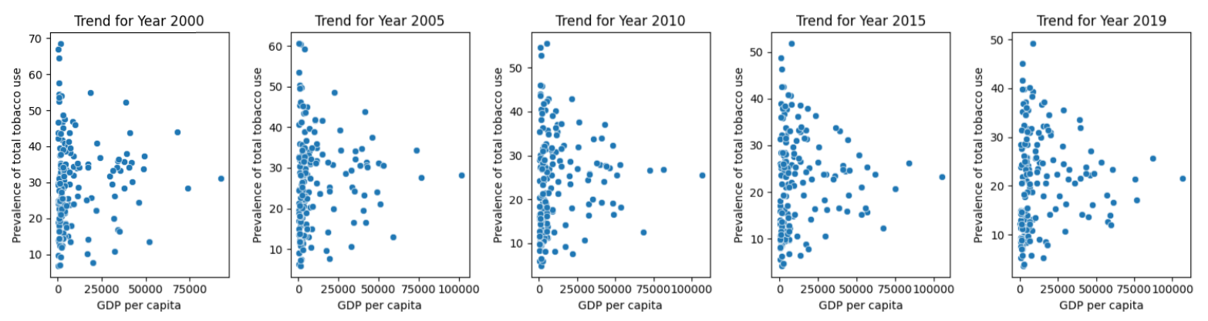
By Year Graph of GDP per capita and Tobacco User
The higher the gdp become, the narrower the range of the tobacco use.
Most countries with more than 60000 dollar GDP per capita maintains below 40%

Slide 14
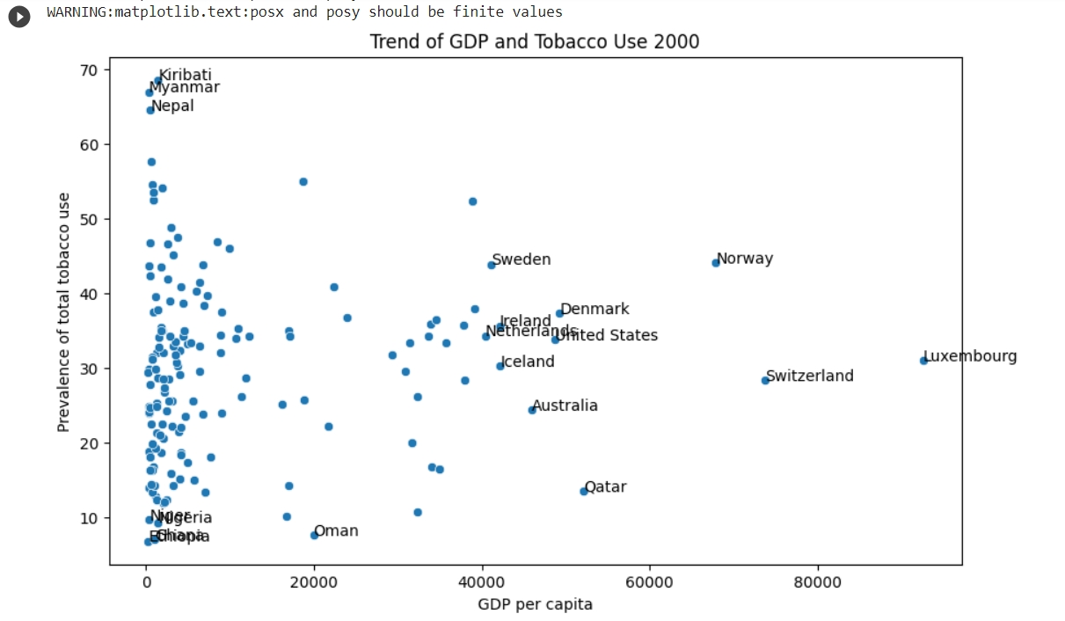
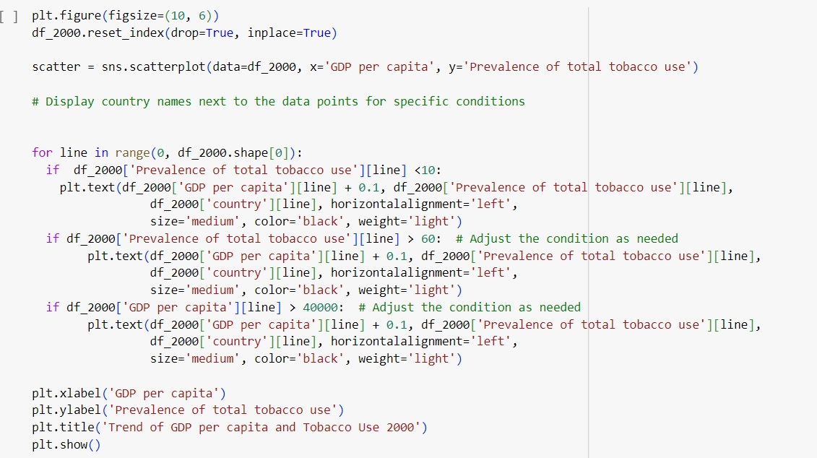
Let’s Take A Look at The Countries!
Explanation: People in very poor countries, like in Africa, do not consume tobacco much since tobacco is hardly affordable, but some poorer countries also have higher access to tobacco if they rely on tobacco industry, e.g. Myanmar, with low tax or almost no control policies. Nations that have adopted effective strategies for tobacco control, encompassing monitoring, smoke-free regulations, smoking cessation programs, health warnings, advertising restrictions, and taxation, have successfully lowered smoking rates and associated health risks, and saved many lives. (Pan American Health Organization, 2017; Islami et al., 2015)

Slide 15
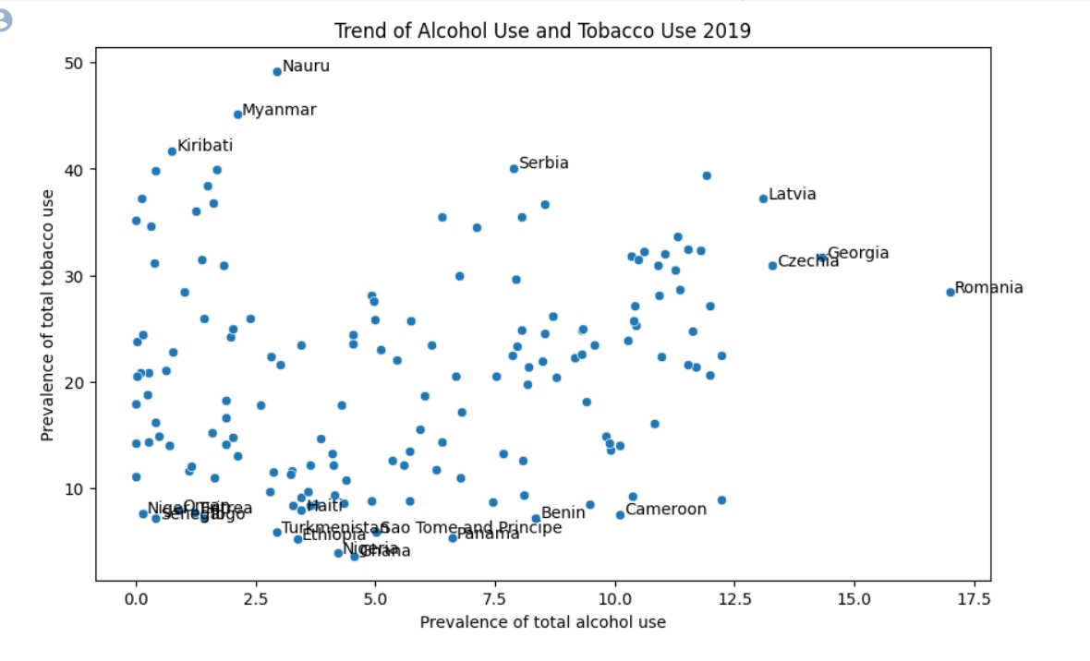
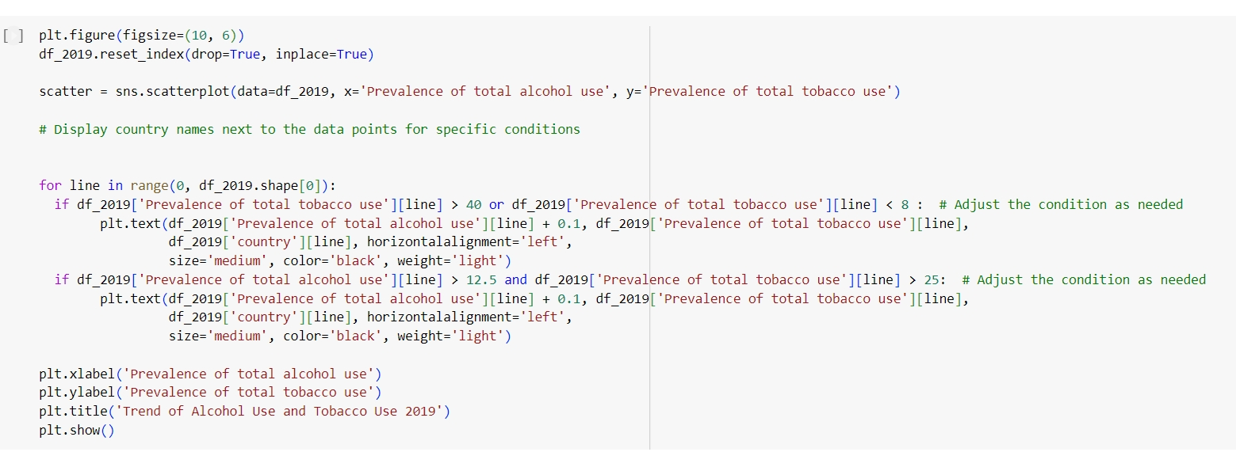
Hypothesis #2: Countries with higher prevalence of alcohol use also have higher prevalence of tobacco use.

Slide 16
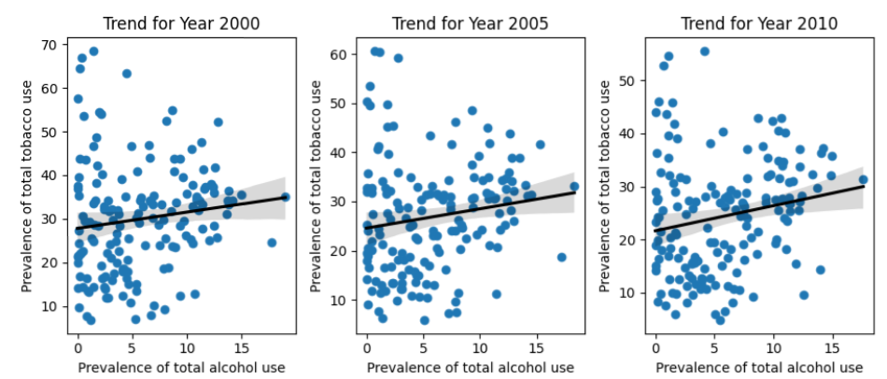
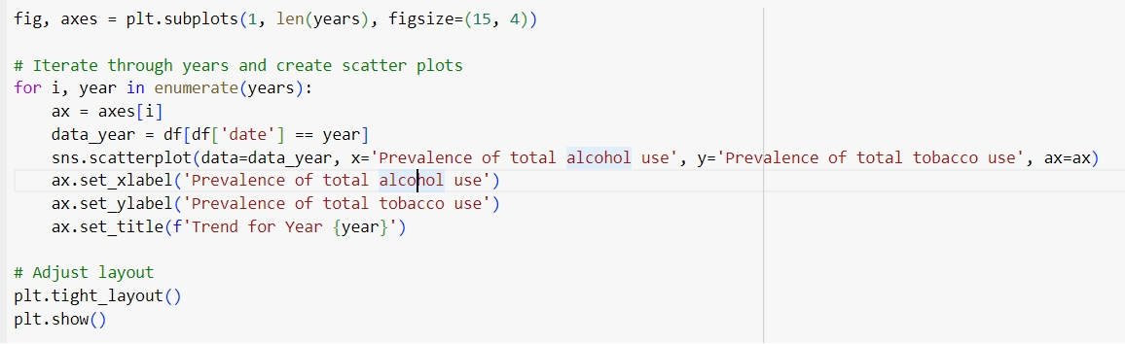
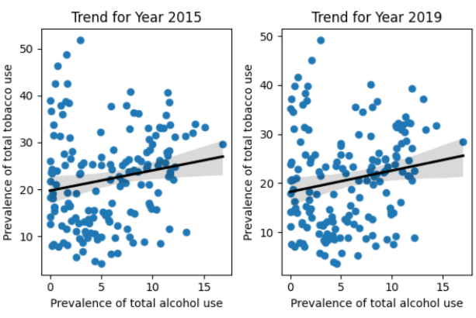
Interpretation: It is likely that the prevalence of tobacco use has a positive relationship with the prevalence of alcohol use.
Explanation: Socioeconomic factors (culture, peers, policies, etc.) are involved (Bobo & Husten, 2000).
⇒ Some countries have drinking and smoking culture. Some have strict policies for both. Some have certain social stigma against either smoking or alcohol.

Slide 17
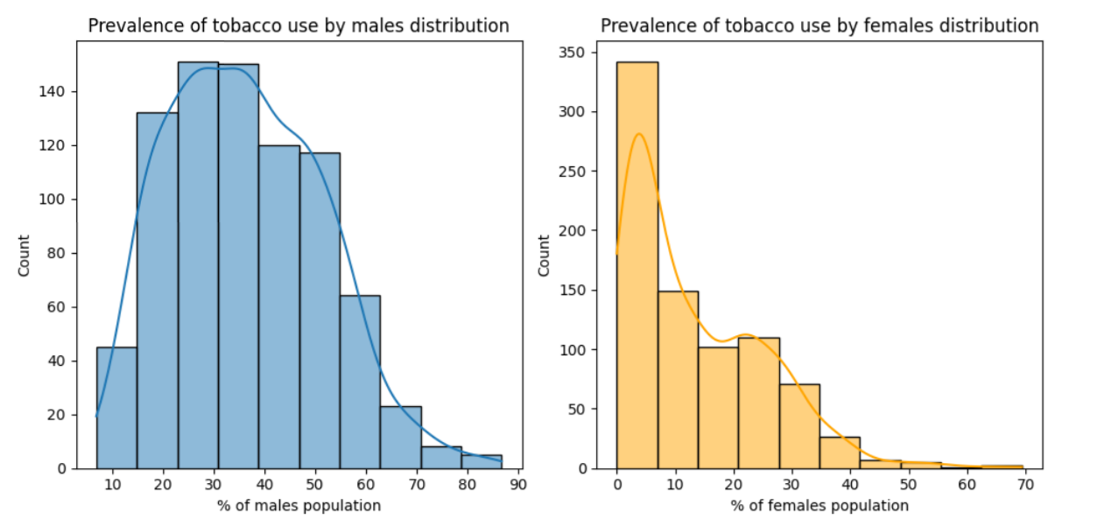
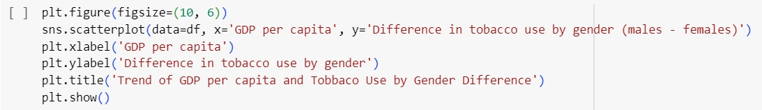
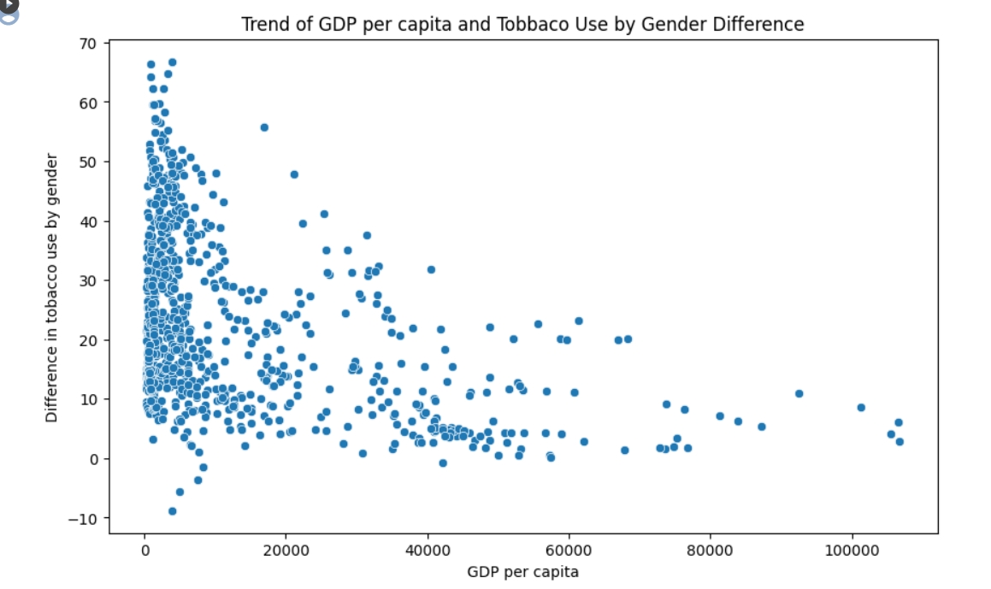
Hypothesis #3: Economically advantaged countries has similar tobacco consumption level between male and female.
Interpretation:
For countries with lower income, a wide range is shown, but the trends converge, mostly decreasing when countries get wealthier, though the difference still persists.
Explanation:
Influence in the control policies meaning fewer men smoke, more gender equality meaning women gets less stigmatized for smoking, also developing countries have higher fertility rate, meaning women tend to smoke less (Hagen et al., 2016).

Slide 18
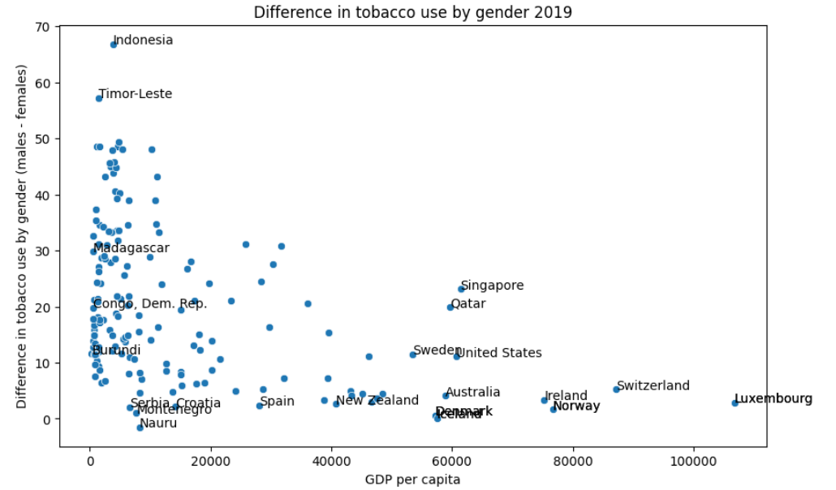
Do you see your countries?

Slide 19
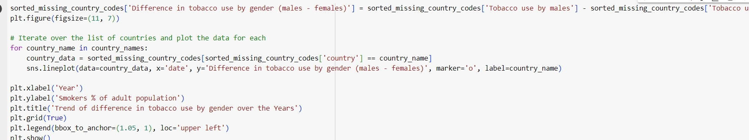
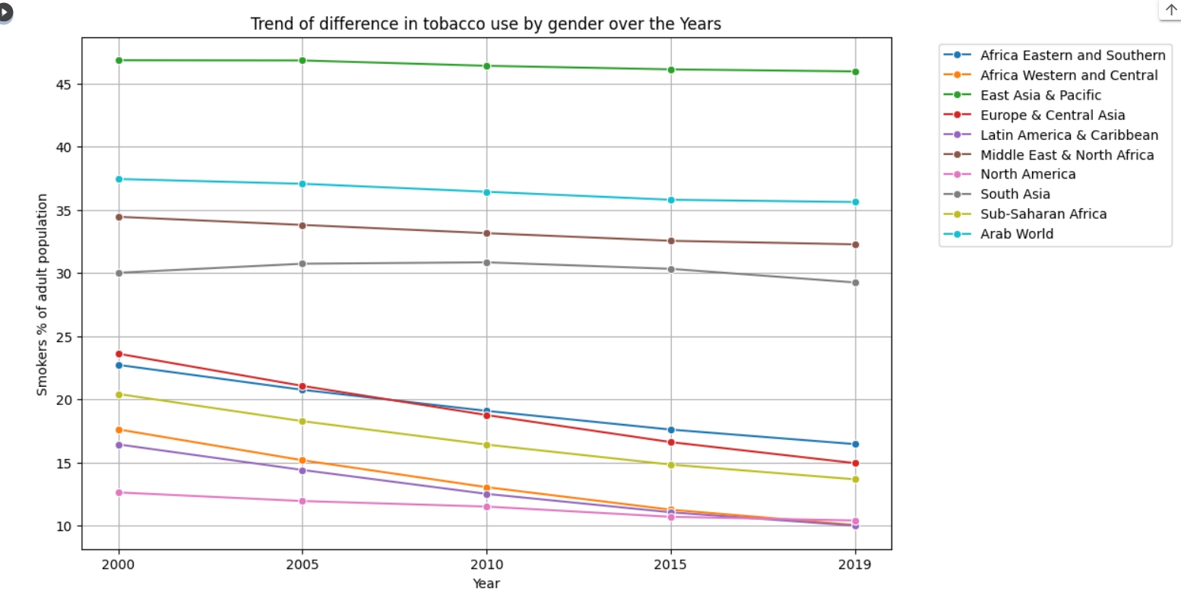
What
about
regions?

Slide 20
CONCLUSION
Hypothesis 1: The more economically advantaged a country is, the higher the prevalence of tobacco use - Unlikely
GDP per capita & Tobacco use prevalence - Little correlation.
However, tobacco use prevalence converge when GDP per capita increases.
Hypothesis 2: Countries with higher prevalence of alcohol use also have higher prevalence of tobacco use - Likely
Tobacco use and alcohol use prevalence - Moderately positive correlation.
Hypothesis 3: Economically advantaged countries has similar tobacco consumption level between male and female - Likely
GDP per capita & difference of tobacco use by gender - Relatively
negative correlation. The wealthier a country is, the less difference is seen in male and female tobacco use.

Slide 21
REFERENCES
Bobo, J. K., & Husten, C. G. (2000). Sociocultural influences on smoking and drinking. PubMed, 24(4), 225–232. https://pubmed.ncbi.nlm.nih.gov/15986717
Hagen, E. H., Garfield, M. J., & Sullivan, R. J. (2016). The low prevalence of female smoking in the developing world: gender inequality or maternal adaptations for fetal protection? Evolution, Medicine & Public Health, 2016(1), 195–211. https://doi.org/10.1093/emph/eow013
Islami, F., Stokłosa, M., Drope, J., & Jemal, A. (2015). Global and regional patterns of tobacco smoking and tobacco control policies. European Urology Focus, 1(1), 3–16. https://doi.org/10.1016/j.euf.2014.10.001
Pan American Health Organization. (2017, July 19). WHO report finds dramatic increase in life-saving tobacco control policies in last decade. PAHO. Retrieved November 1, 2023, from https://www3.paho.org/hq/index.php?option=com_content&view=article&id=13496:who-report-finds-dramatic-increase-in-life-saving-tobacco-control-policies-in-last-decade&Itemid=0&lang=en#gsc.tab=0

Slide 22
THANK YOU FOR YOUR ATTENTION!

